Slide 1
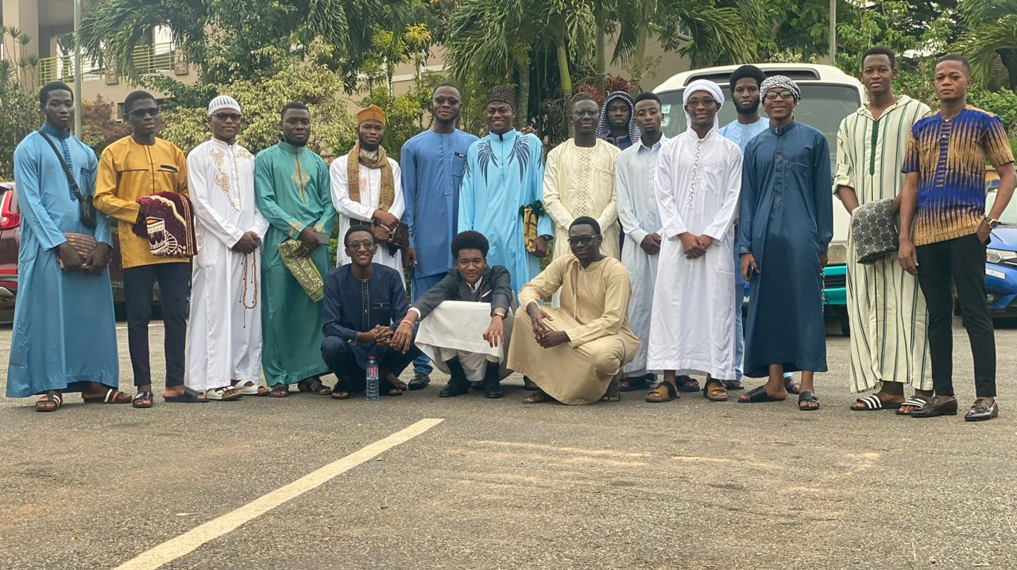
Ashesi Muslim Community
AMC warmly welcomes its fellow ADU students

Slide 2
What is Ashesi Muslim Community?
Ashesi Muslim Community (AMC) is a faith based community that incubate all Muslim students in Ashesi. It is non-denominational. Hence, all Muslim, with their sects, are welcome and treated equally.

Slide 3
Ashesi: Muslim Perspective
Ashesi is a diverse and inclusive institution.
Ashesi advocates for equality and fairness.
How does that relate to Muslims?

Slide 4
How do Muslims live in Ashesi?
Despite Ashesi, being a secular and liberal institution.
Everyone is welcome and allowed to express their religion.
Hence, no faith based prosecution or discrimination occurs on campus.

Slide 5
What do we do?
Manage and oversee the well-being of Muslim Students.
Address challenges faced by Muslim Students.
Organize activities and events to keep the Muslim community connected.

Slide 6
Activities/Events
General Meetings (twice in a semester).
Arabic Language teaching (Contact me Adim).
Qura’n Recitation (Contact Imam Mubashir).
Seminars/Lectures (Will be coordinated).

Slide 7
Moreover.......
As a Muslim body, we have to take care of each other.
In terms of,
Academia,
Life and family issues,
Career advising.

Slide 8
Conclusion
We are here to help each other. Therefore , REACH OUT!

Slide 9
Questions
Thank you/ Merci Beaucoup!

